Slide 1
Create to Regenerate
Chapter 6

Slide 2
Relation between GDP and pollution
Using global material footprint
1990 - 2007 pollution grew by:
Germany: 9%
Japan: 14%
US, UK, Australia: 30%
Spain, Portugal, Netherlands: 50%

Slide 3
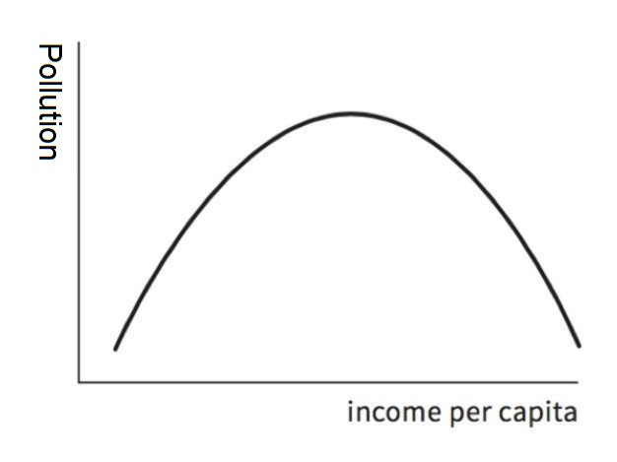
Old view: Growth will clean it up
90s, Grossman, Kruger
Environmental
Kuznets Curve
Notes:
Do not have the resources to spare to deal with environment

Slide 4
When countries grew, citizens could afford to:
Demand higher standards
Do not need to wait to demand clean air and water
Start using cleaner technologies
Do not need to wait to demand more stringent standards
Shift from manufacturing to services
This shift just moves pollution elsewhere

Slide 5
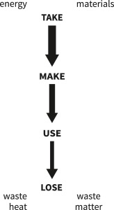
Caterpillar: Cradle-to-Grave chain
Deal with “negative externalities”:
quotas + taxes
eg. Germany, eco-tax
Tiered pricing
eg. Santa Fe, water use
Problem: Not enough

Slide 6
Current Mindset: Capitalism
Creates just one form of value = financial,
for just one interest group = shareholders.

Slide 7
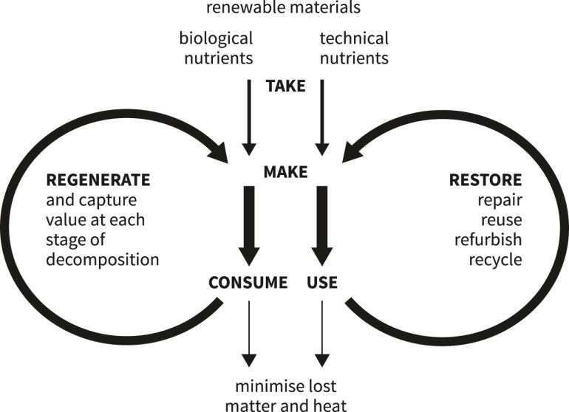
Butterfly: cradle-to-cradle
Biological wing
Technological wing
(No loop can recapture 100% of its materials)

Slide 8
Growing Mindset: Circular
Example:
Caterpillar, a construction equipment company
By recover key component parts:
Gross profit increased by 50%
Water and energy use decreased by ~90%

Slide 9
Larger idea
Go beyond the individual
To the connected

Slide 10
Make circular future open
Create a knowledge commons
Build products on principles of:
Modularity - easy to take apart
Open Standards - Common shape and size
Open Source - Info on composition and use
Open Data - Info on location and availability
Goal: Anyone can see how to reuse a products materials,
independent of the original company

Slide 11
Create system where we are not just harmless to nature’s cycles,
But are helpful participants in their regeneration

